Slide 1
DEMO :
Researcher Personas

Slide 2

WHY SEQUENCE DNA ? Unlocking the Power of DNA for Indonesia’s Health
For the Ministry of Health of Indonesia, DNA sequencing is more than science, it is a tool for better healthcare and stronger policy.
Medical benefits: Detect cancer mutations, develop gene therapies, study autoimmune diseases, and enable preventive medicine.
Public health impact: Early screening for birth defects, discovery of new drug targets, and personalized treatment.
Beyond healthcare: DNA forensics, food safety in import/export, and reliable paternity testing.
By investing in genomic analysis and machine learning, the Ministry can transform DNA data into actionable insights — building precision healthcare, supporting national research, and protecting the health of all Indonesians.
A
T
C
G

Slide 3
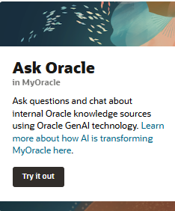

Use Case : EDA and Predictive AI Model Development for Genomic
Goals
Load genome dataset into a secure data platform
Generate k-mer datasets for sequence analysis
Train machine learning and deep learning models for prediction and classification tasks
Evaluate model accuracy and interpret results for health-related insights
USER 1
Role : Bioinformatician / Genomic Data Scientist (at Ministry of Health RI)
Current Activity: Conducting genomic data analysis and developing predictive machine learning models to support public health research and policy making..
Challenges
Limited availability of scalable platforms for genomic data analysis
Complexity in preparing k-mer based datasets and large-scale EDA
High computational requirements for ML models such as Random Forest and Neural Networks
Integration issues between raw genomic data sources and ML pipelines
Objective
Perform exploratory data analysis (EDA) and build predictive ML/DL models using genome datasets, including k-mer based representations, to identify genomic patterns and support hypothesis testing for healthcare-related research.
Solutions
Use of a high-availability ML & Data Science platform on OCI
GPU/CPU flexibility to handle large genomic datasets efficiently
Seamless integration with Ministry of Health databases and data warehouse for research and policy support

Slide 4
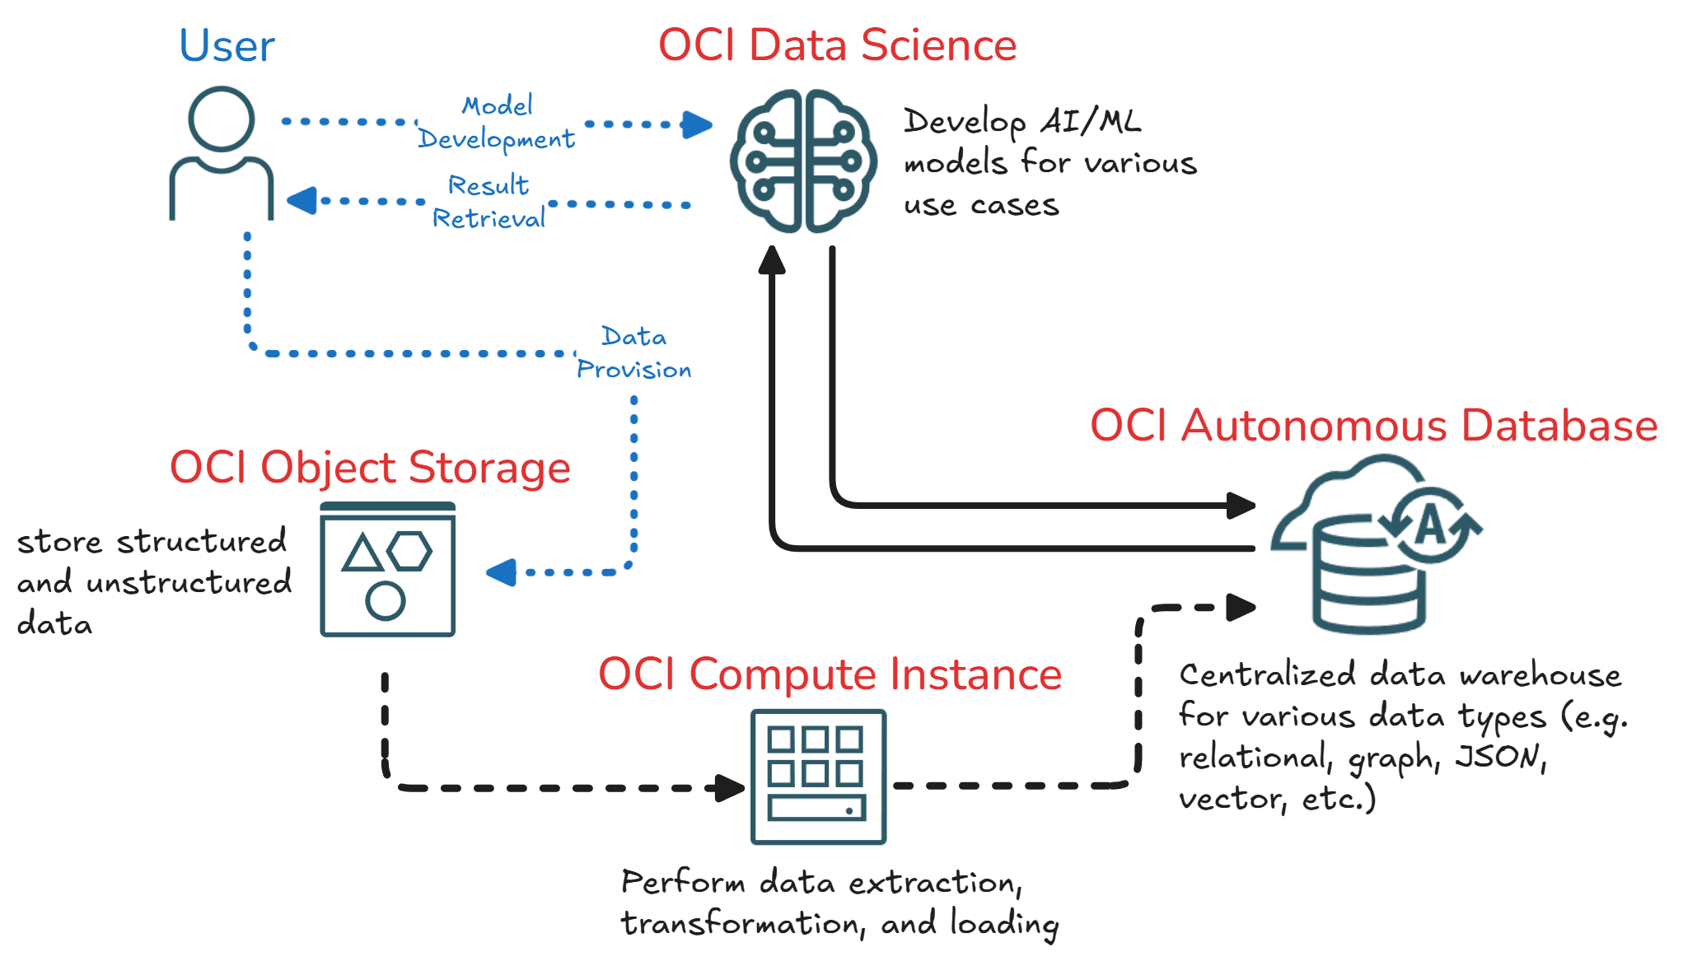
Use Case : Exploratory Data Analysis and Predictive AI Model Development

Slide 5

Better care.
Better outcomes.
Better together.

Slide 6


